Slide 1
Voluntary and mandatory standards
o Difference between voluntary and mandatory standards
o Agencies that mandate standards
o Role of government in legislating mandatory standards
17.5.3 Contrast voluntary and mandatory standards and provide examples
of each
Unit C 17.5 Global Medical Equipment Regulations
Module 279-17-C Regulations, Standards and Ethics
©
Voluntary & Mandatory standards
dr. Chris R. Mol, BME, NORTEC, 2015

Slide 2
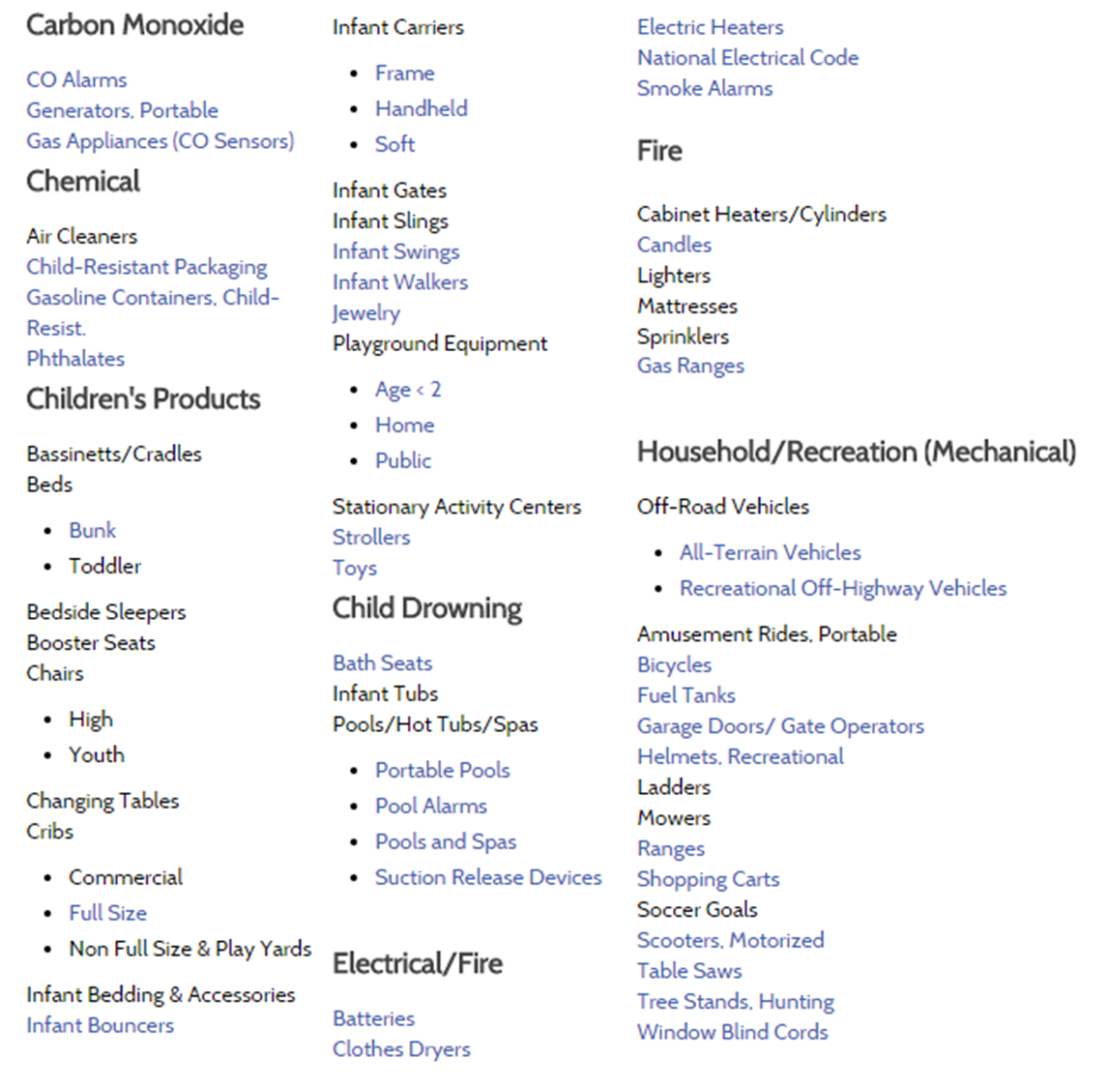
Voluntary vs Mandatory standards
Most standards are Voluntary
Examples of Voluntary Standards (USA)
Voluntary and Mandatory Standards
©
Voluntary & Mandatory standards
dr. Chris R. Mol, BME, NORTEC, 2015

Slide 3
Standards can be mandated (become Mandatory) by a
Company: ‘All our medical equipment should have be painted in our Brand colours’
Professional society: ‘BMET’s in Zambia should keep an inventory in their hospital’
Industry: ‘Medical Devices should be electrically safe through following IEC 60601’
Government: ‘All hospitals in Zambia should maintain an inventory’
Trade Agreement: ‘Import of Chinese equipment should come with an English language user manual’
with each Mandatory Standard it must be specified what the sanction is for ‘non-compliance’.
A Standard may be called a Regulation
when it becomes mandated by a government or an international trade agreement.
©
Voluntary and Mandatory Standards
dr. Chris R. Mol, BME, NORTEC, 2015

Slide 4
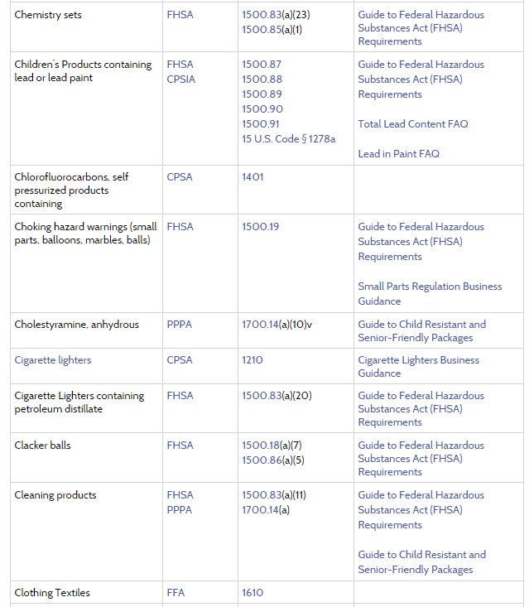
Examples of Mandatory Standards (USA)
and there are
many, many more …..
http://www.cpsc.gov/en/Regulations-Laws--Standards/Regulations-Mandatory-Standards-Bans
©
Voluntary and Mandatory Standards
dr. Chris R. Mol, BME, NORTEC, 2015

Slide 5
Examples of Mandatory Standards (USA)
Final and Proposed Rules
High Chairs, Infant Bouncer Seats, Children's Folding Chairs and Stools, Infant Bath Tubs, Portable Hook-On Chairs, Frame Child Carriers, Substantial Product Hazard List: Extension Cords, Corded Window Coverings, Prohibition of Children's Toys and Child Care Articles Containing Specified Phthalates, Recreational Off-Highway Vehicles, Seasonal and Decorative Lighting Products, Magnet Sets, Sling Carriers, All-Terrain Vehicles (ATVs), Soft Infant and Toddler Carriers, Hand-Held Infant Carriers, Strollers and Carriages, Bedside Sleepers, Bath Seats, Toddler Beds, Full-Size Cribs, Bassinets and Cradles, Cigarette Lighters Certificates of Compliance, ….
©
Voluntary and Mandatory Standards
dr. Chris R. Mol, BME, NORTEC, 2015

Slide 6
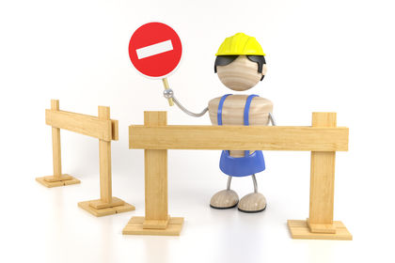
Role of government in legislating mandatory standards
When a standard is mandated by a government or an international trade agreement, it may be called a Regulation and it normally becomes Legally Obligatory.
Countries that are considering making standards mandatory should take into account the potential consequences under international agreements on technical barriers to trade.
A barrier to trade is a government-imposed restraint on the flow of international goods or services.
The most common barrier to trade is a tariff—a tax on imports. Tariffs raise the price of imported goods relative to domestic goods (goods produced at home)
In other words: make sure that you do not make certain standards mandatory for import products in your country if these are in conflict with international regulations,
unless you want to pick a fight…
©
Voluntary and Mandatory Standards
dr. Chris R. Mol, BME, NORTEC, 2015

Slide 7
END
The creation of this presentation was supported by a grant from THET:
see https://www.thet.org/

